Slide 1
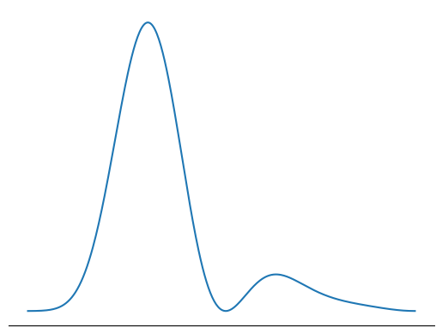
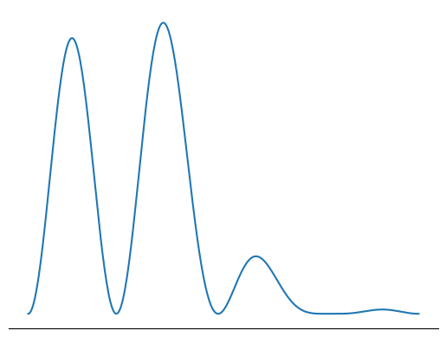
Teacher (Qwen-2.5-VL-7B)
Transformer Block 1
Transformer Block 2
Transformer Block 3
Transformer Block 28
Teacher Logits
28 Heads
. . . .
28 Heads
28 Heads
. . . .
. . . .
28 Heads
. . . .
Attn-Loss
Attn-Loss
Attn-Loss
KL
CE
. . . . . . .
. . . . . . .
Ground Truth
16 Heads
16 Heads
Transformer Block 1
Transformer Block 2
Transformer Block 3
Transformer Block 36
Student Logits
. . . . . . .
. . . . . . .
16 Heads
16 Heads
Student (Qwen-2.5-VL-3B)

Slide 2
H_{T} 1
H_{T} 2
H_{T} 28
Teacher Heads
. . . . .
Student Heads
. . . . . . . . . .
H_{S} 1
H_{S} 16

